Slide 1


INFN use-case: Open Access Repository R. Barbera, R. Bruno, M. Fargetta, R. Rotondo
InvenioRDM Project Meeting, CERN, 20-24 January 2020

Slide 2
INFN towards Plan S adoption
2007: join SCOAP³
2008: signs Berlin declaration
2010: signs Granada declaration
2013: signs MedOAnet position paper
2014: signs Messina 2.0 declaration
2018: join OA2020
2018: join Plan S
Notes:
Sponsoring Consortium for Open Access Publishing in Particle Physics, iniziativa internazionale per convertire le pubblicazioni scientifiche riguardanti il mondo della fisica, con accesso ristretto, con accesso libero in modo che possano essere accessibili da tutte e riutilizzate.

Slide 3
Requirements for an INFN Open Access Repository
Compliant with Plan S
Support widely adopted protocols
Store all kinds of digital assets
Automatically harvest and store INFN-authored documents from other repositories
Support the management during the periodic national research assessments (VQR)
Increase the visibility of both INFN research and researchers
Compliant with EOSC guidelines
No available solutions that fulfill all the above requirements at once
Notes:
VQR Research Quality Assesment

Slide 4
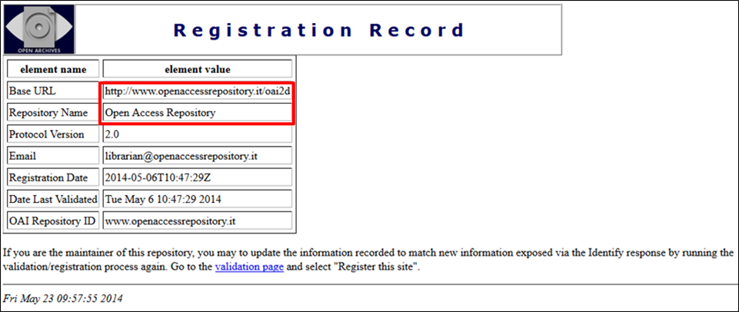
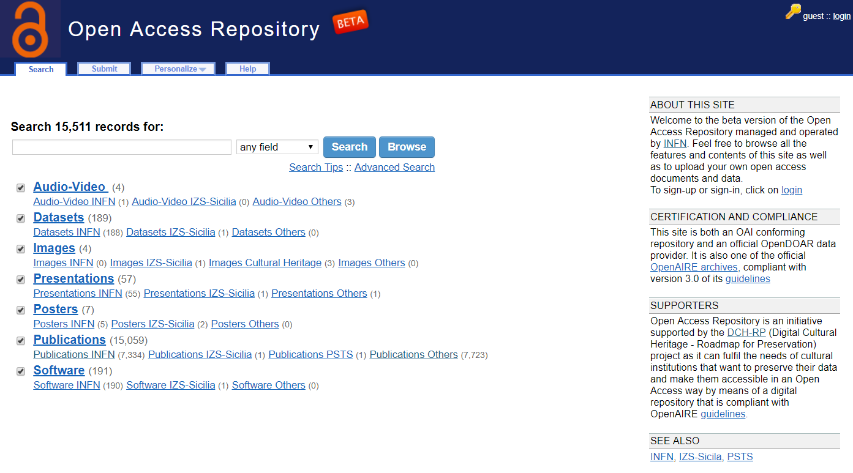
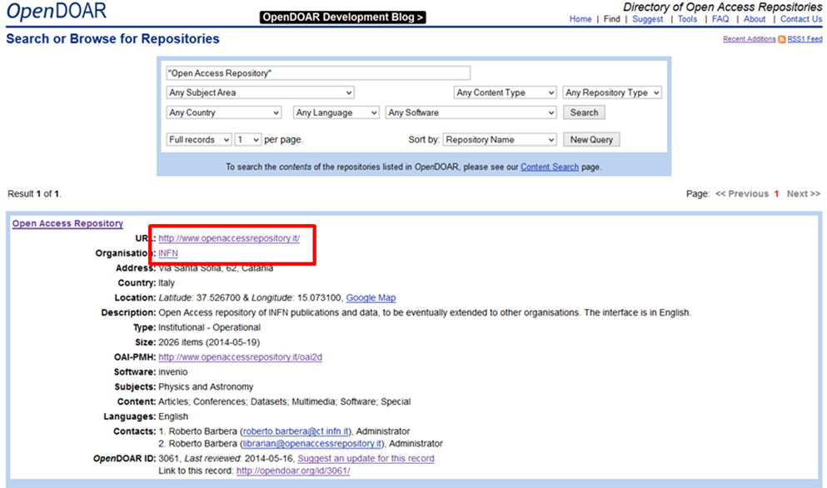
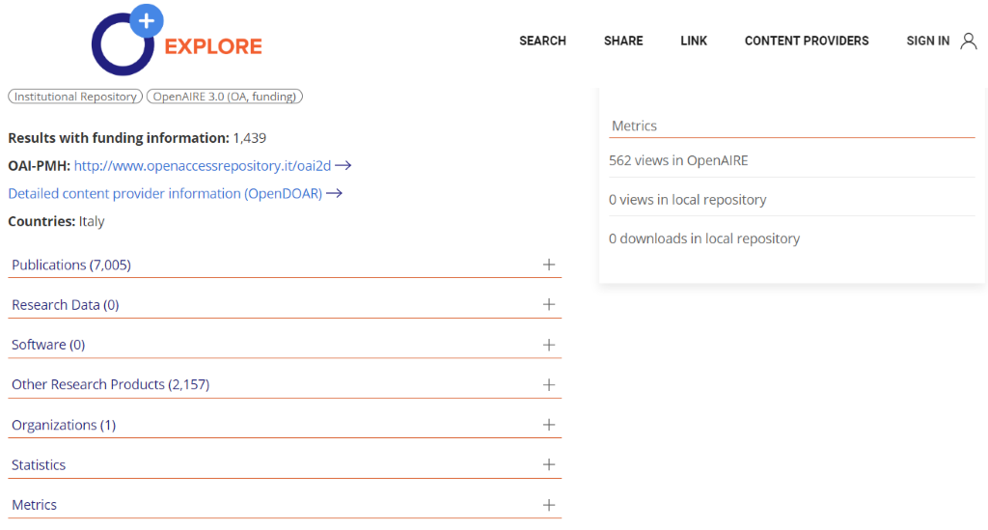
The (pilot of the) INFN Open Access Repository
Developed at Catania since 2014
Intended to be a single entry point for the deposit of research outputs and other digital assets
Uses standards to exchange metadata with other repositories (e.g., arXiv, SCOAP³)
Notes:
OpenDOAR, directory di oar OpenAIRE indexing di articoli su oar

Slide 5
Evolution to new OAR to support Plan S
Migrate from Invenio v1.2 to Zenodo (based on Invenio v3)
Customise the Zenodo GUI to fit the look and feel of the INFN OAR
Integration with eduGAIN
SAML based authentication
Re-engineering of backend architecture into micro-services
Kubernetes
CI/CD
First deployed at the end of 2018
Open for use since the end of March 2019

Slide 6
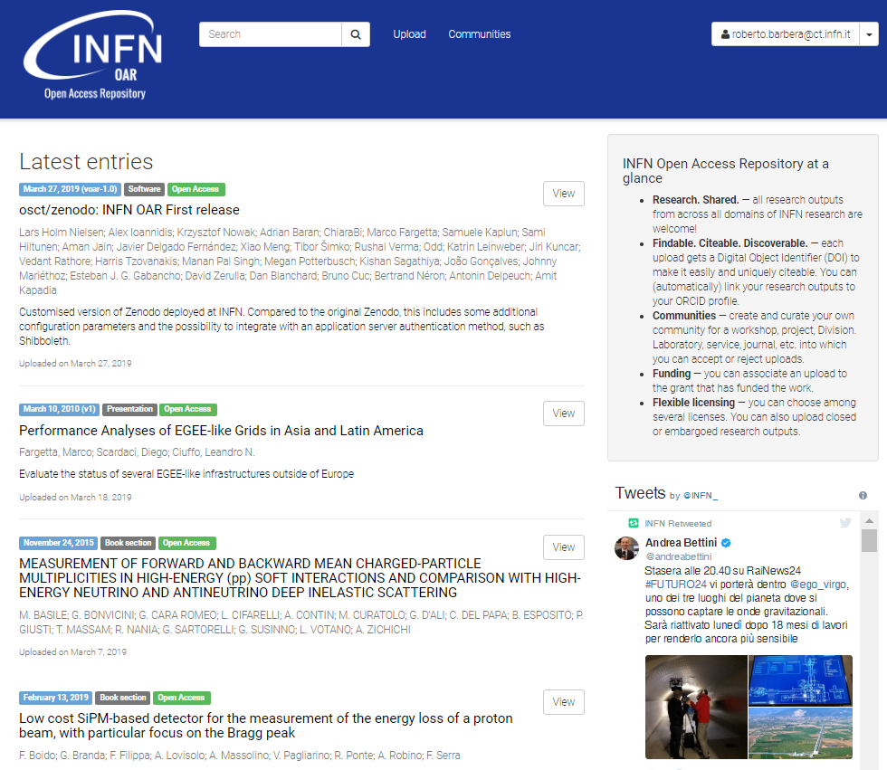
The new INFN Open Access Repository
https://openaccessrepository.it

Slide 7
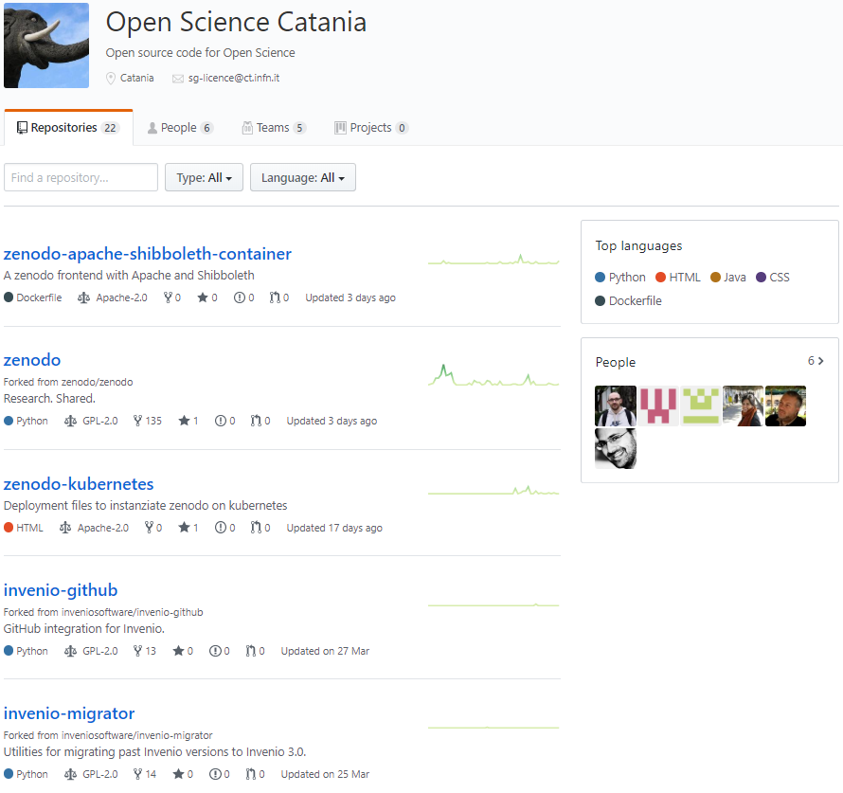
Code available on GitHub
https://github.com/osct

Slide 8
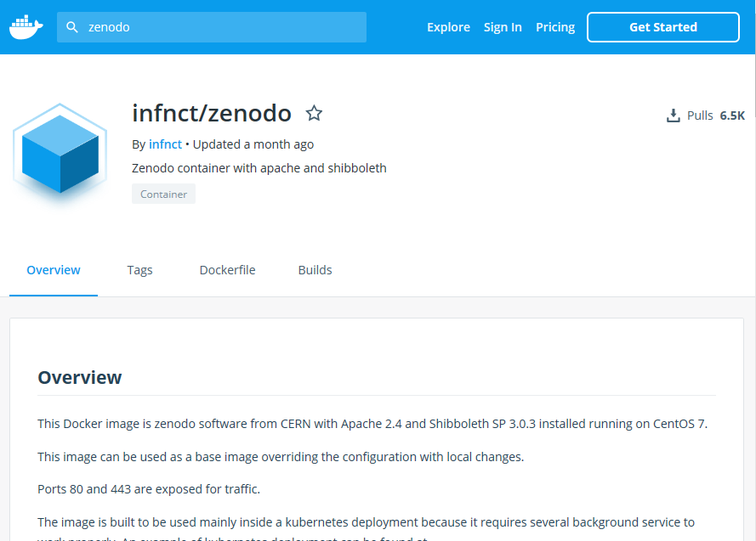
Continuous delivery
https://hub.docker.com/r/infnct/zenodo
Notes:
aggiungere link

Slide 9
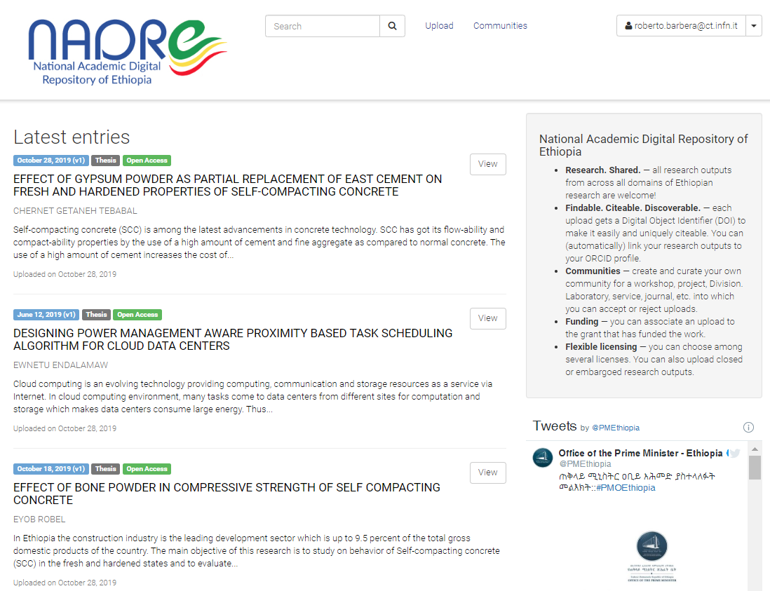
Adoption outside INFN
NADRE: National Academic Digital Repository of Ethiopia
National initiative under the umbrella of the Ministry of Science and Higher Education
Built by the Ethiopian NREN (EthERNet)
Based on the INFN OAR
They just cloned containers and code repositories, and customised the theme
https://nadre.ethernet.edu.et

Slide 10
Reproducibility and Reusability Platform
Tries to enhance the FAIR principles
It combines INFN OAR and the EGI’s SSOD platforms
It allows to seamlessly reproduce results published in the OAR
It ensures sensitiveness of data and published software
Tested with: Physical Activity Lifelong Modelling & Simulations experiment
Anastasia Anagnostou, Brunel University London – United Kingdom
Simon J. E. Taylor, Brunel University London – United Kingdom.
Work presented at:
Beilstein Open Science Symposium 2019 (both poster and presentation)
WACREN 2020 – (abstract accepted)
OR2020 – (abstract submitted)

Slide 11
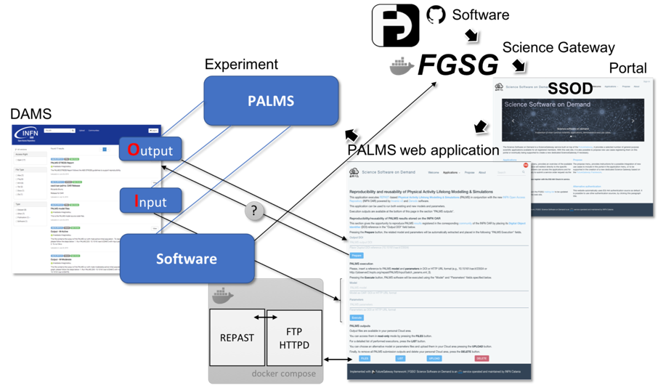
Overview

Slide 12
How it works
The FutureGateway Science Gateway is a Science Gateway built using the FutureGateway Framework
The Science Software On Demand is an EGI’ service built for EOSC-hub european project
FAIR Science Examples/Reproducibility and reusability of Physical Activity Lifelong Modelling & Simulations
4
1
2
5
3
FGSG
INFN OAR (PALMS)
RRP
PALMS Interface in EGI’s SSOD

Slide 13
Future Gateway Framework
Possible use cases
FutureGateway
https://futuregatewayframework.github.io
Notes:
The FutureGateway is the core component of the FutureGateway Framework
It essentially consists of three components:
A database
An API server front-end
A Daemon process + pluggable Executor Interfaces
The Framework provides facilities to install and maintain the software

Slide 14
Current and future activities
Conceptual Design Report (CDR)^{(*)} under evaluation by INFN Management
OAR proposed to be the INFN "FAIR" repository
Better integration with Zenodo APIs
DOIs navigation through REST APIs
^{(*)} Written in collaboration with S. Bianco, D. Menasce, M. Maggi and L. Patrizii

Slide 15
Thanks!

